Slide 2
The Indian Child Welfare Act (and the Minnesota Indian family preservation act)
U.S.C. § 1901 et. seq.
Minn. Stat. § 260.751 et. seq.

Slide 3
History- Before ICWA
Indian children placed in out of home care at alarmingly high rates
Nationwide, 10-20 times more frequently than non-Indian children
In Minnesota from 1972-1974
Out of home placements 5 times more frequent for Indian children
1/4 Indian children under the age of 1 were adopted
nearly 98% of Indian children placed for adoption were placed with non-Indian families.

Slide 4
Purpose of ICWA
“The Congress hereby declares that it is the policy of this Nation to protect the best interest of Indian children and to promote the stability and security of Indian tribes and families by the establishment of minimum federal standards for the removal of Indian children from their families and the placement of such children in foster or adoptive homes which will reflect the unique values of Indian culture, and by providing for assistance to Indian tribes in the operation of child and family programs.” (emphasis supplied).

Slide 5
Some Things to Keep in Mind:
Many states have codified ICWA provisions
Minnesota Indian Family Preservation Act,
adopted 1985
Courts must apply the state or federal standard, whichever has a higher standard of protection of the rights of a parent or Indian Custodian. 25 U.S.C. § 1921
Full faith & credit must be given to public acts, records & judicial proceedings of an Indian Tribe applicable to child custody proceedings. 25 U.S.C. § 1911 (d)

Slide 6
When does ICWA Apply?
“Indian Child”
(2) “Child Custody Proceeding”
Child Removed from a “Parent” or “Indian Custodian”
If all three criteria exist, application of both ICWA and MIFPA is mandatory. 25 U.S.C. § 1903 (4); Minn. Stat. § 257.351, subd. 6

Slide 7
“Indian Child”
Unmarried
Under the age of 18
Either:
A Member of a recognized tribe OR
Eligible for enrollment in a recognized tribe
Note: The Federal law requires that an eligible child also be the biological child of a member. 25 U.S.C. § 1903(4)
Tribe determines eligibility for membership and determination is binding on state and federal governments
ICWA applies even if the Tribe is wrong

Slide 8
“Child Custody Proceedings”
Involuntary proceedings in State Court
Types of Cases Governed by both ICWA & MIFPA:
CHIPS
TPR
Voluntary Placements
Adoptions
Status Offenses
Guardianships
Third Party Custody Cases
Delinquency Cases (if placement based on parent’s unfitness or child’s needs)
Some other cases

Slide 9
“Parent” or “Indian Custodian”
Parent:
biological parent, or an Indian person who has adopted an Indian child under state law or tribal law or custom.
Indian Custodian:
any Indian person who has legal custody under state law, tribal law or custom, or to whom temporary physical care, custody and control has been transferred by a parent of such child.
25 U.S.C. § 1903 (6),(9)

Slide 10
ICWA Protections
Jurisdiction provisions
Notice
Transfer to Tribal Court
Intervention of Tribe
GAL provisions
Right to counsel
QEW
Active Efforts (Not Reasonable Efforts)
Additional Requirements for Voluntary TPRs and Voluntary Foster Care Placements

Slide 11
Jurisdiction
NO state court jurisdiction if:
The child lives/resides on a reservation with jurisdiction over child custody matters
Child is already a ward of a tribal court
NO state court jurisdiction if:
Concurrent Jurisdiction

Slide 12
Transfer of Actions to Tribal Court
State courts shall transfer to a tribal court on the Petition of either parent or the tribe UNLESS:
Either parent objects
Tribe declines to exercise jurisdiction
Any party opposing transfer demonstrates “good cause” not to transfer
NEVER socio-economic conditions or perceived (in)adequacy of tribal social services
Transfer is discretionary where:
Proceedings are at a late stage and transfer was not promptly sought
Child over 12 years old objects

Slide 13
Notice Requirements
Mandates notice to parents, Indian Custodians, and tribes of the action.
Notice to be provided to all tribes in which a child may be eligible for enrollment
If not sure of tribal affiliation, provide notice to the Secretary of the Interior, who will provide proper notice
Emergency Holds- notice to Tribe by phone or fax
Short time frames for providing notice

Slide 14
Notice Requirements-Contents of Notice
Contents of the notice:
Child’s name, birthdate, birthplace, tribal affiliation
Names and information regarding parents/Indian Custodians
Copy of Petition, name of petitioner
Name & address of Petitioner’s attorney
Statement of rights to intervene, counsel, transfer/object to transfer
Availability of additional 20 days for preparation, if requested
Information regarding the court
Statement of consequences of an adjudication on future
parental/custodial rights
Statement to tribe regarding confidentiality of information

Slide 15
Right of Tribe to Intervene
In foster care/TPR proceedings, Tribe can intervene
Mandatory, can be exercised at any point.
Tribal representative
Why?
Ensure Tribal participation if not transferred
Monitor ICWA compliance
Educate state courts
Resource for information regarding cultural/social standards of the Tribe

Slide 16
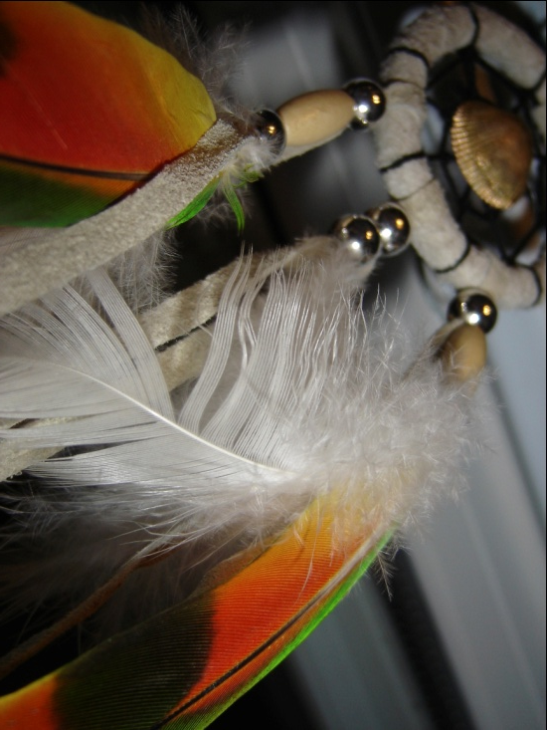
GAL Provisions (MIFPA only)
Appointment of a GAL who is Indian, and preferably a member of the child’s tribe
If not possible, GAL should demonstrate
knowledge and appreciation of
the child’s tribal heritage.

Slide 17
Right to Counsel
Gives indigent Parents and Indian Custodians the right to counsel.
If not provided for in state law, the Secretary of the Interior will pay reasonable fees for counsel.

Slide 18
QEWs
Why? To reduce the risk of cultural bias by providing the court with evidence regarding social and cultural standards and child-rearing practices of the tribe.
QEWs are:
Member of the tribe recognized by the tribe as knowledgeable in tribal customs in child-rearing
Lay expert with substantial experience in providing child and family services to Indians/extensive knowledge of prevailing social and cultural standards and child-rearing practices within the child’s tribe
Professional person with substantial education and experience with substantial knowledge of prevailing social and cultural standards and child-rearing practices within the Indian community.

Slide 19
QEW & Burdens of Proof
The Court must make a determination that continued custody is likely to result in serious emotional/physical damage to the child.
Foster Care:
Determination must be supported by clear and convincing evidence, including testimony by a QEW.
TPR:
Determination must be supported beyond a reasonable doubt, including testimony by a QEW.

Slide 20
Active Efforts
Active efforts must be made to provide services designed to prevent the breakup of the Indian Family.
NOT “Reasonable Efforts”

Slide 21
Voluntary TPRs & Voluntary Foster Care Placements
Must be in writing
Must be signed before a Judge
Must be accompanied by a
certification by the Judge.
If procedure not followed:
Withdrawal Provisions
Final decrees of adoption can
be vacated

Slide 22
Placement Preferences
Placement Preferences in Tribal Law will trump.
MIFPA: If Tribe has intervened, agencies must defer to tribal judgment as to the suitability of a particular home.

Slide 23
Placement Preferences – Default Provisions
25 U.S.C. § 1915(a)
Foster care/pre-adoptive placement
Extended Family member
Foster home licensed, approved, specified by child’s tribe
Indian foster home otherwise licensed
Institution approved by a tribe or operated by an Indian organization
Adoptive Placement
Extended family member
Member of the child’s tribe
Other Indian families

